Slide 1
α β γ
Alpha, Beta and Gamma Radiation
Xtra

Slide 2
Magnetic fields and Radiation
N
What will happen to the particles in the magnetic field?
Will they be affected or not?
Why?
Answer for each type of radiation
Alpha
Can anyone think of where this may be happening right now!
+ve
Beta
-ve
HINT : what charge is each radiation mediator
Gamma
EMR
Magnetic Field
S

Slide 3
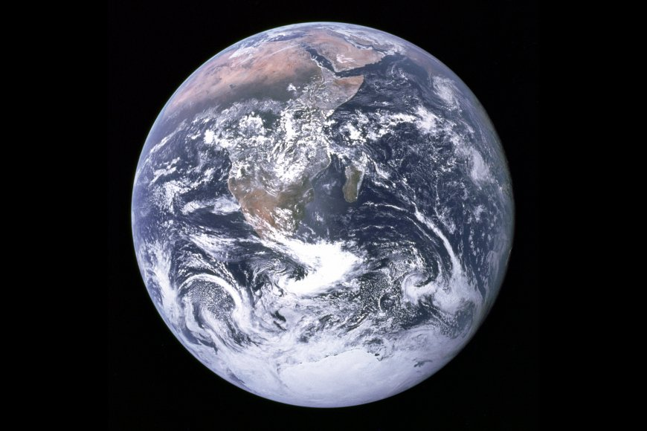
Above us….
These Belts called the Van Allen Belts trap ALPHA and BETA radiation within them, making them very dangerous places for Astronauts.
N
S

Slide 4
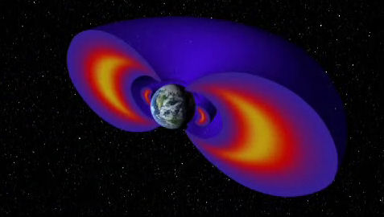
NASA
These belts are so dangerous to humans that space craft actually avoid these when there are people on board!!
They are also known as the Bermuda triangle of space

