Slide 1
P3 Flashcards

Slide 2
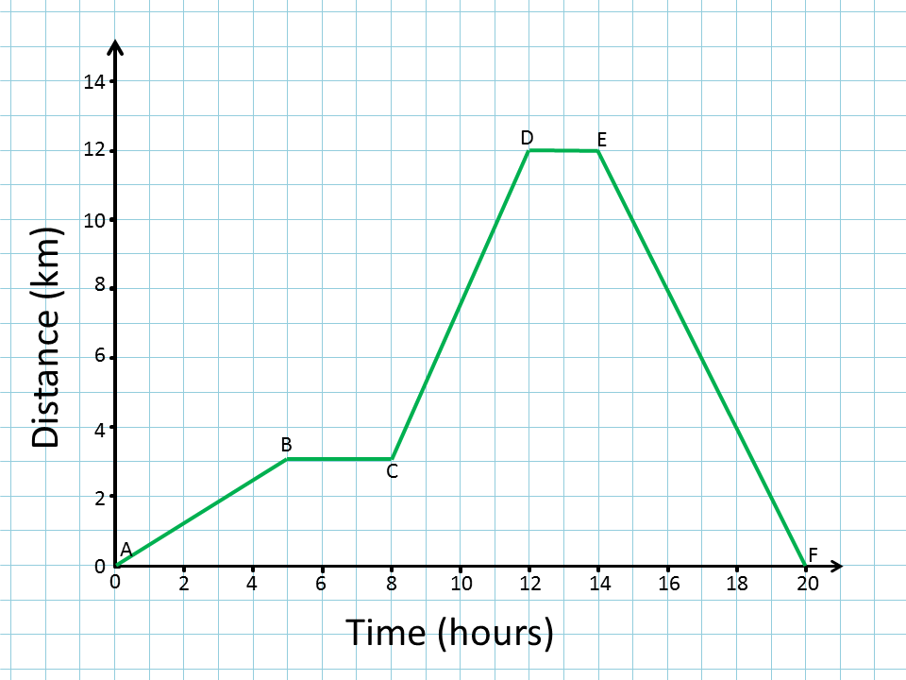
Distance
Triangle: Distance (m)________
average speed (m/s) x time (s)
Relationships:
If you increase the speed you will increase the distance travelled in the same time
Increasing the speed reduces the time taken to cover the same distance
Distance-time graphs
Gradient (y/x) = speed
Curved line = changing speed
Flat line = not moving

Slide 3
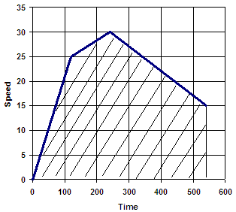
Speed
Speed-time Graph
Gradient (y/x) = acceleration
Gradient down = deceleration
Distance = area under the graph
Curved line = changing acceleration
Acceleration
Change in speed, direction or both
Triangle: change in speed (m/s)___
acceleration (m/s²) x time (s)
Relative Velocity
If moving in the same direction take away the numbers
If moving in the opposite direction add the numbers

Slide 4
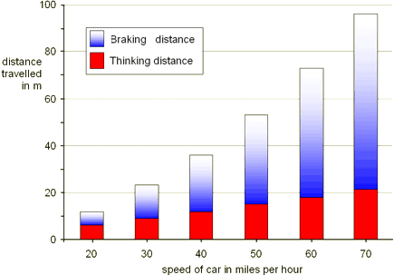
Stopping Distance
Stopping distance = thinking distance + braking distance
Thinking Distance
Factors that increase it: tiredness, alcohol/drugs, more speed, distractions
Linear relationship with speed: as speed x2, thinking distance x2
Braking Distance
Factors that increase it: icy/wet roads, poor brakes/tyres, more speed
This is because it is affected by friction, mass, speed and braking force
Squared relationship with speed: as speed x2, braking distance x4

Slide 5
Equations
Force (N)_________ Work done (J)______
mass (kg) x acceleration (m/s²) force (N) x distance (m)
Weight (N)________________ Work done (J)__
mass (kg) x gravitational field strength (N/kg) power (W) x time (s)
Power (W)_____
force (N) x speed (m/s)
Remember: all equations are at the front of the exam, you just need to rearrange, remember the rules!
Top of the divide, top of the triangle
Times by, goes at the bottom

Slide 6
Kinetic Energy
Triangle: Kinetic Energy (J)______
0.5 x mass (kg) x velocity²(m/s)
KE = energy when moving
If the speed x2 the braking distance & kinetic energy x4
Battery Powered cars
Uses electricity from power station to charge it up (so creates CO2)
But reduces pollution when its being used
Fuel consumption is effected by:
Mass, friction, driving style, speed, road conditions

Slide 7
Momentum
Triangles: Momentum (kgm/s)__ Change in momentum(kgm/s)
mass (kg) x velocity (m/s) force (N) x time (s)
Force (N)_________
mass (kg) x acceleration (m/s²)
Collisions:
If you can increase the time the momentum change happens in you can decrease the force (reduces injuries) e.g. seatbelts, crumple zones, airbags
Work by increasing stopping distance & increasing stopping time
The change shape, absorb energy & reduce injuries
Use crash test dummies, sensors & collecting real crash data to develop car safety features
ABS Brakes
Work by pumping the brakes on and off, to avoid a skid
This is Newton’s second law of motion

Slide 8
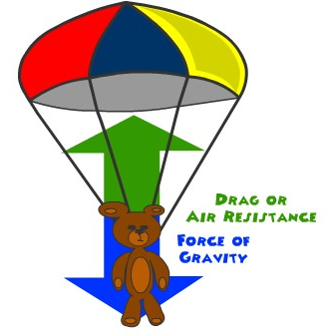
Falling
Forces
Unbalanced = change in speed or direction
Balanced = maintain speed
Terminal Speed
Weight and drag are balanced
Higher speed = more drag
Larger area = more drag
Acceleration due to gravity (also called gravitational field strength)
Same for any object at a given point on the Earth’s surface
Not affected by the atmosphere
Slightly different up a mountain or down a mine shaft

Slide 9
Gravitational Potential Energy
Triangle: GPE (J)____________
mass(kg) x gravity (N/kg) x height (m)
GPE = KE so therefore mgh = 0.5 x m x v²
So for an object falling to Earth h = v² / 2g
Falling Body at Terminal Speed
Kinetic energy stays the same
GPE is turned into heat through friction heating the air
Roller-coasters
As the car goes up it increases in GPE, as it goes down, GPE turns into KE
Mass x2 = KE x2
Speed x2 = KE x4

