Slide 1
C4 Flash Cards

Slide 2
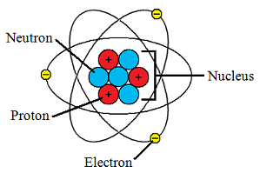
Atom
Electron: mass = 0; charge = negative
Proton: mass = 1; charge = positive
Neutron: mass = 1; charge = neutral
Atoms are neutral as no. of electrons = no. of protons
Atom Radius = 10⁻¹⁰m
Atom Mass = 10⁻²³g
Isotope: same atomic number, different mass number
E.g. Carbon 12 & Carbon 14
Atomic Theory
Dalton: smallest thing is the atom
JJ Thompson: discovered electron
Rutherford: electrons orbit a nucleus
Unexpected result from Geiger & Marsden’s gold foil experiment
Bohr: electron shells

Slide 3
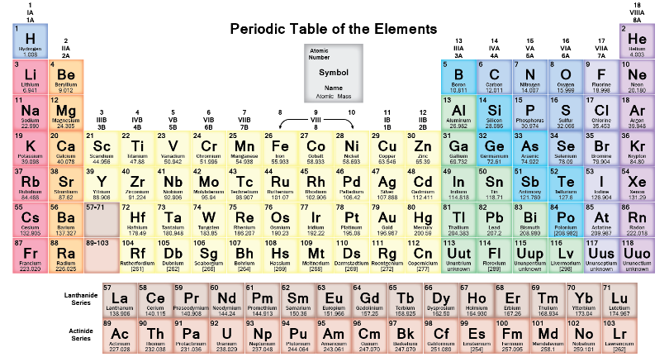
Periodic Table
Atomic number = number of protons
Atomic number = number of electrons
Mass number = number of protons + number of neutrons
Group = number of electrons in the outer shell
Period = number of electron shells
Periodic Table Development
Newlands
Used atomic mass & properties, every 8th similar
Mendeleev
Used atomic mass & properties. Predicted undiscovered elements

Slide 4
Ionic Bonding
Atoms want to be stable with an outer shell of 8 electrons
Transfer of electrons between metal and non-metal
+ -
Na Cl
Only conduct when ions can move
Can form giant ionic lattice
High melting point as strong ionic bonds

Slide 5
Covalent Bonding
Non-metal shares electrons with non-metal
Cl Cl
CO2 & H2O have weak intermolecular forces and low melting points
No free electrons so can’t conduct electricity

Slide 6
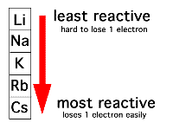
Group 1: Alkali Metals
1 electron in their outer shell (form positive ions)
2Na + 2H2O → 2NaOH + H2
More reactive as you go down the group
Increasing atomic radius
Weaker attraction between electrons and nucleus
Easier to lose electrons (oxidation: OIL)
Flame Test
Moisten flame test wire
Dip in sample
Put into blue Bunsen flame
Record colour

Slide 7
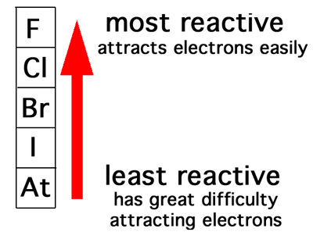
Group 7: Halogens
Outer shell has 7 electrons (Form negative ions)
Less reactive as you go down the group
Increasing atomic radius
Weaker attraction between electrons and nucleus
Harder to attract electrons (reduction: RIG)
Appearance
Chlorine = green gas
Bromine = orange liquid
Iodine = grey solid
Group 1 metal + Halogen → Metal Halide
2Na + Cl2 → 2NaCl
Displacement Reactions
Halogens higher up the group displace those lower down the group
2KBr + Cl2 → 2KCl + Br2

Slide 8
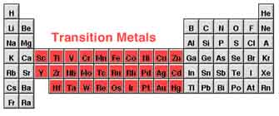
Transition Metals
Appearance
Copper compounds = blue
Iron (II) compounds = light green
Iron (III) compounds = orange
Thermal Decomposition (break down with heat, see a colour change)
Metal carbonate → Metal Oxide + Carbon Dioxide
FeCO3 → FeO + CO2
Sodium Hydroxide Tests (coloured precipitate/solid forms)
Cu²⁺ = blue
Fe²⁺ = green
Fe³⁺ = orange

Slide 9
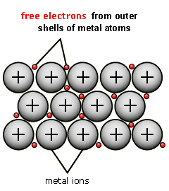
Metals
Definition: strong attraction between a sea of delocalised electrons and close packed metal ions
Properties of metals
High melting points due to strong metallic bonds
Conduct electricity due to free electrons
Superconductors
Metal at very cold temperature that conducts with no resistance

Slide 10
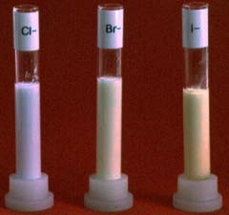
Water
Pollutants in Water
Nitrate from fertilisers
Lead from pipes
Pesticides from fields
Purifying Water
Filtration: remove large bits
Sedimentation: let small bits settle out
Chlorination: add chlorine to kill bacteria
Testing Water
Testing sulphates with Barium Chloride
white precipitate if positive
Testing halides with Silver Nitrate
white if chloride, cream is bromide & yellow is iodide

