Slide 1
C3 long answer and structure exam questions Mark scheme

Slide 2
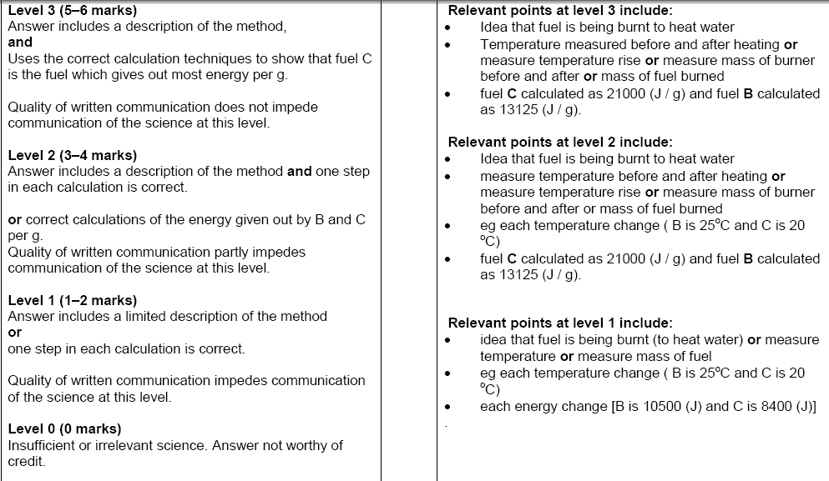
Question 1

Slide 3
Question 2
Any 5 from (1 mark each):
takes years to develop few compounds actually work some are toxic they must pass safely tests raw materials hard to find / extract long term trials to look for side effects
1 mark for QWC
Total 6 marks

Slide 4
Question 3: Diamond and graphite
a
b

