Slide 1
B4 Flash Cards

Slide 2
Capture Recapture
Estimate = no. in 1st sample x no. in 2nd sample
no. previously marked
Assumptions (things need to believe are true)
Nothing has died
Sampled the same way both times

Slide 3
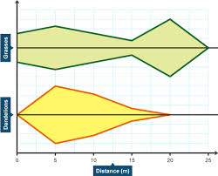
Zonation
Definition
Change in distribution (where organisms are) across a habitat, caused by a change in abiotic (non-living) factor
E.g. Rocky Shore: some species need to spend more time under water so are lower down the shore
Shown by Kite Diagram
Easy to see at a glance: the wider the line the more individuals

Slide 4
Osmosis
Definition:
Net movement of WATER from an area of high WATER concentration to an area of low WATER concentration through a partially permeable membrane.
Plants cells
Water moves in, they swell up: TURGID
Water moves out & membrane pulled away from cell wall: PLASMOLYSED
Animal Cells
Water moves in, they burst because they don’t have a cell wall: LYSIS
Water moves out, they shrivel: CRENATION

Slide 5
Diffusion
Definition:
Net movement of gases from an area of high concentration to an area of low concentration
Where it happens:
Gases move in and out the stomata in the leaf
Air spaces in spongy mesophyll

Slide 6
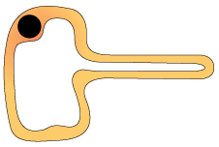
Active Transport
Definition
Movement of minerals from an area of low concentration to an area of high concentration, this needs energy
Where does it happen?
Root hair cells (large surface area)

Slide 7
Photosynthesis
Symbol Equation
6CO2 + 6H2O → C6H12O6 + 6O2
Glucose Uses
Stored as starch (won’t move in the cell)
Turned into cellulose for cell walls
Leaf Adaptations
Upper epidermis is transparent to let light through
Palisade cells have lots of chloroplasts to do photosynthesis
Spongy mesophyll has lots of air spaces for diffusion
Pigments
Chlorophyll a & b; Carotene, absorb different wavelengths of light

Slide 8
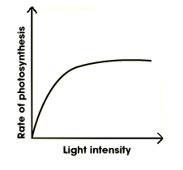
Photosynthesis
Limiting Factors
CO2 & Light: as they increase, photosynthesis increases until something else becomes the limiting factor
Temperature: as it increases photosynthesis increases until enzymes denature
Scientists
Van Helmont: measured weight of soil & plant and said it must be making its own food
Priestly: Put a mouse and a plant in a sealed jar, this shows the plant made oxygen
Two steps:
Water split by light (O2 & H ions)
CO2 combines with H ions

Slide 9
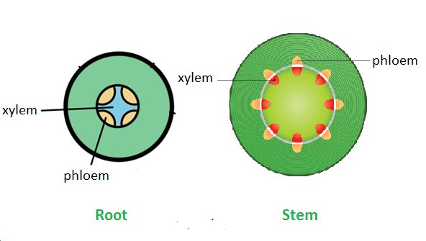
Transport in Plants
Xylem
Carries water and minerals (transpiration), cells are dead & hollow
Phloem
Carries sugar, cells are alive
Factors that speed up transpiration
More light
More wind
More temperature
Less Humidity
Guard cells close stomata when less water as they go flaccid

Slide 10
Decay
To decay microorganisms need:
Moisture for reproduction
Oxygen for respiration
Warmth for faster enzyme movement
Detritivores
Increase the surface area of dead plants & animals
E.g. earthworms, maggots & woodlice
Saprophytes
Break down dead plants and animals into minerals
E.g. bacteria and fungi
Extracellular digestion: secrete enzymes and absorb products

Slide 11
Minerals
Mineral | Molecule Made | Deficiency
Nitrogen | Amino acids & Proteins | Short & Yellow
Magnesium | Chlorophyll | Yellow

Slide 12
Farming
Organic:
Crop rotation: change what you grow each year
Add manure instead of fertiliser
Biological control (use animals to eat pests
Intensive:
Pesticides: but can build up in the food chain killing top predators
More efficient (get more food)
Hydroponics: grow plants in mineral solution instead of soil

